Slide 1
Temporary Storage
CGPRT(W) : Ensuring Clean Seas and Coasts in Western Region ……

Slide 2
Aim
Understand the operational aspects of temporary storage including support equipment and accessories required.
CGPRT(W) : Ensuring Clean Seas and Coasts in Western Region ……

Slide 3
Issues
Types of waste
Temporary/intermediate storage
Transportation
CGPRT(W) : Ensuring Clean Seas and Coasts in Western Region ……

Slide 4
Waste management challenges can seriously affect the response efficiency
CGPRT(W) : Ensuring Clean Seas and Coasts in Western Region ……

Slide 5
Waste Hierarchy
Response priority should be to minimize waste production as much as possible!
Reduce
Reuse
Recycle
Recover
Dispose
CGPRT(W) : Ensuring Clean Seas and Coasts in Western Region ……

Slide 6
Storage Requirements
Liquid:
Oil
Oil/water mixture
Emulsion
Solid:
Oiled sediment
Oiled driftwood/seaweed
Oiled debris
Cleaning materials
Sorbent materials
PPE
CGPRT(W) : Ensuring Clean Seas and Coasts in Western Region ……

Slide 7
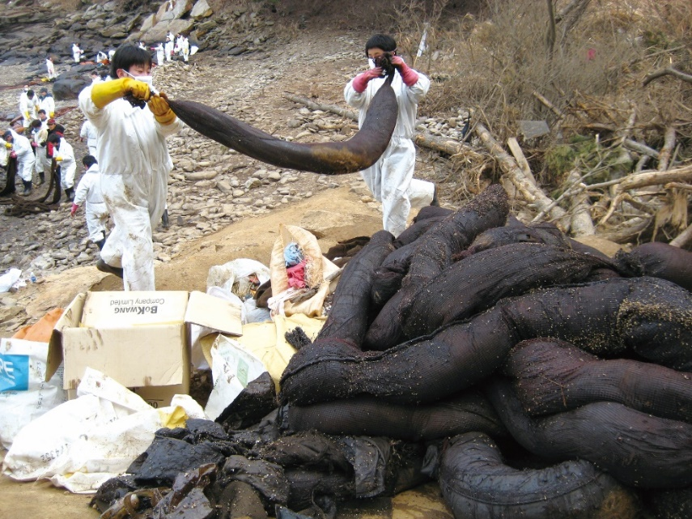
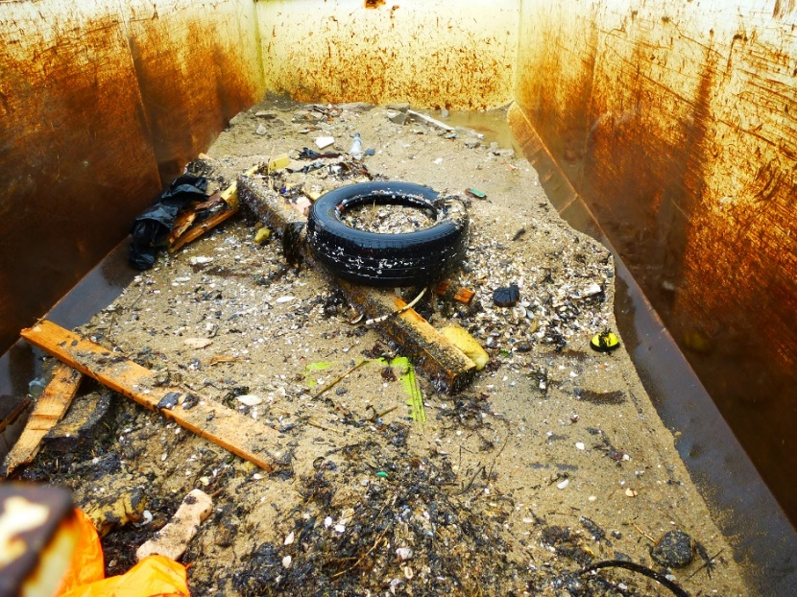
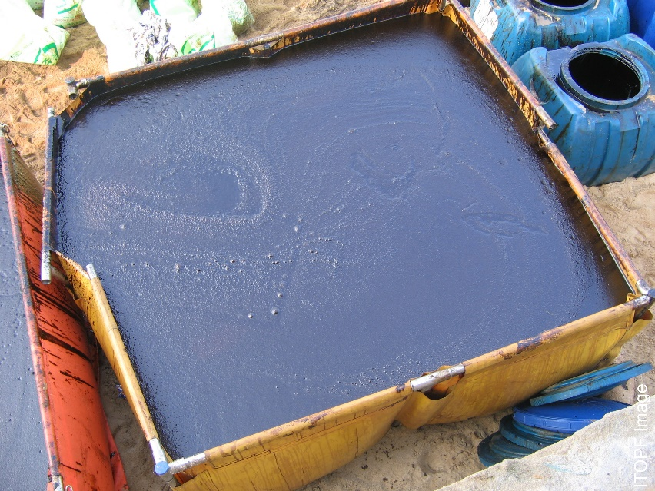
Types of Waste
CGPRT(W) : Ensuring Clean Seas and Coasts in Western Region ……

Slide 8
Temporary Storage
Significant quantities of waste are generated during clean-up operations:
Mainly by recovery at sea and shoreline clean-up;
Less waste generated by using dispersants and in situ burning.
If no storage is available, recovery operations will have to stop!
Important to think about the waste stream before beginning oil recovery operations.
Storage areas should have security.
CGPRT(W) : Ensuring Clean Seas and Coasts in Western Region ……

Slide 9
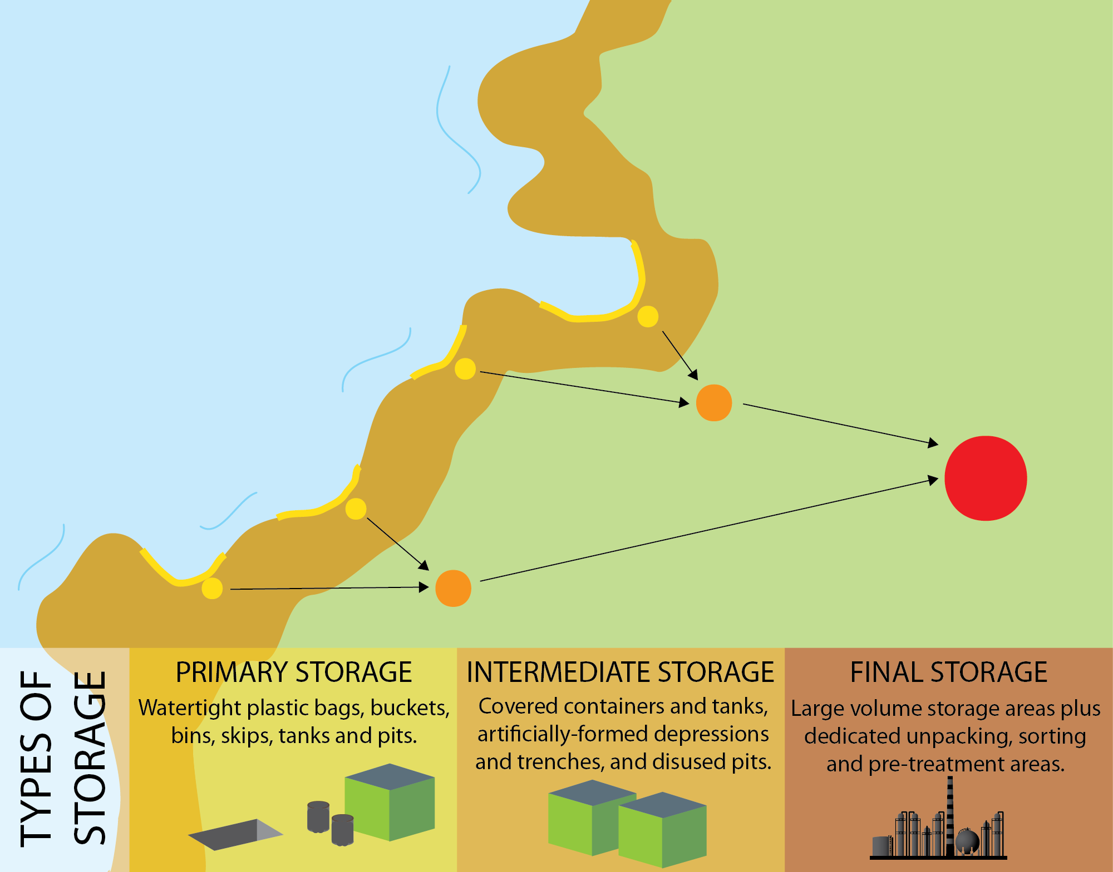
Waste Stream
Source: OSRL
CGPRT(W) : Ensuring Clean Seas and Coasts in Western Region ……

Slide 10
Temporary Storage
At sea:
Barges
Vessel tanks
Floating tanks
Onshore:
Skips
Portable tanks
Drums
Lined excavated (temporary) pits
Plastic bags
CGPRT(W) : Ensuring Clean Seas and Coasts in Western Region ……

Slide 11
Temporary Storage − at Sea
Barge – rigid, floating purpose built storage tanks
Vessel tanks – tanks on a vessel:
may be difficult to get vessel to agree to store oil in their tanks;
are the tanks heated in case of viscous oil?
Vessel tanker – purpose built ship with oil storage tanks.
Floating tanks – bladders/inflatable – purpose built flexible storage.
CGPRT(W) : Ensuring Clean Seas and Coasts in Western Region ……

Slide 12
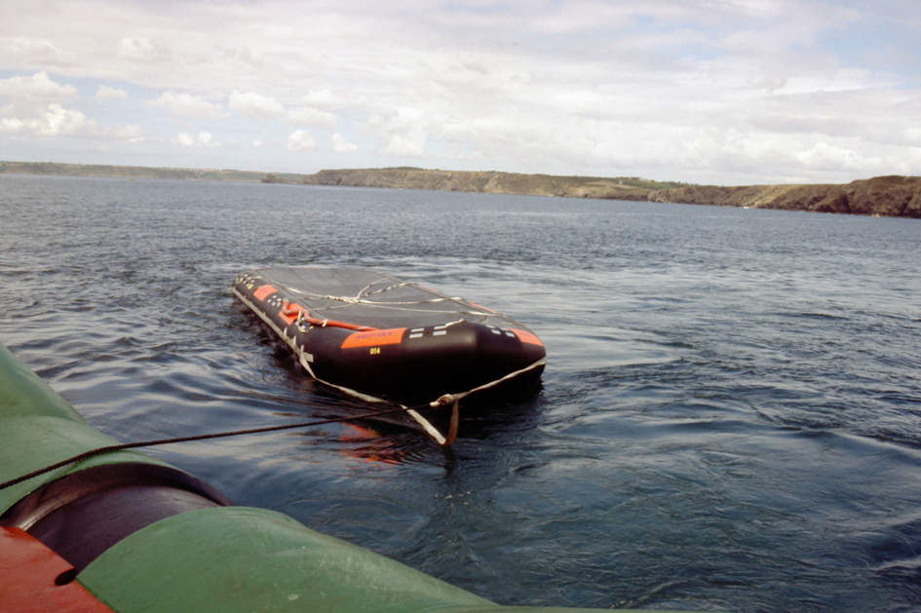
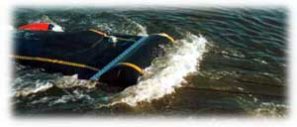
Temporary Storage − at Sea
CGPRT(W) : Ensuring Clean Seas and Coasts in Western Region ……

Slide 13
Temporary Storage − at Sea
Limits on-water recovery operations.
Small portable tanks on deck must be secured and be aware of free surface effect on vessel.
Storage units may be shuttled to shore so that replacement units can ensure on-water recovery can continue.
CGPRT(W) : Ensuring Clean Seas and Coasts in Western Region ……

Slide 14
Temporary Storage − at Sea
Decanting can reduce storage requirements – may require permit.
Oily water separators may be an option on oily liquid waste to reduce waste.
Output must comply with regulations.
CGPRT(W) : Ensuring Clean Seas and Coasts in Western Region ……

Slide 15
Temporary Storage − at Sea
Oily mixtures collected at sea will require port facilities to be unloaded.
Requires suitable location to offload floating storage – i.e. adequate depth; how is the floating storage unit going to offload at the shoreline/wharf?
Viscous products may be difficult to offload from storage tanks at low temperatures – heating coils.
CGPRT(W) : Ensuring Clean Seas and Coasts in Western Region ……

Slide 16
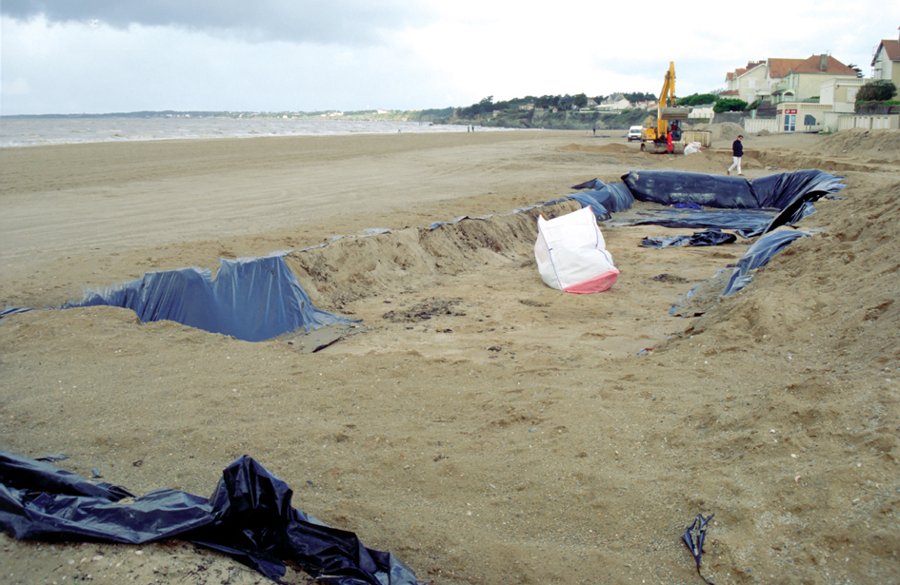
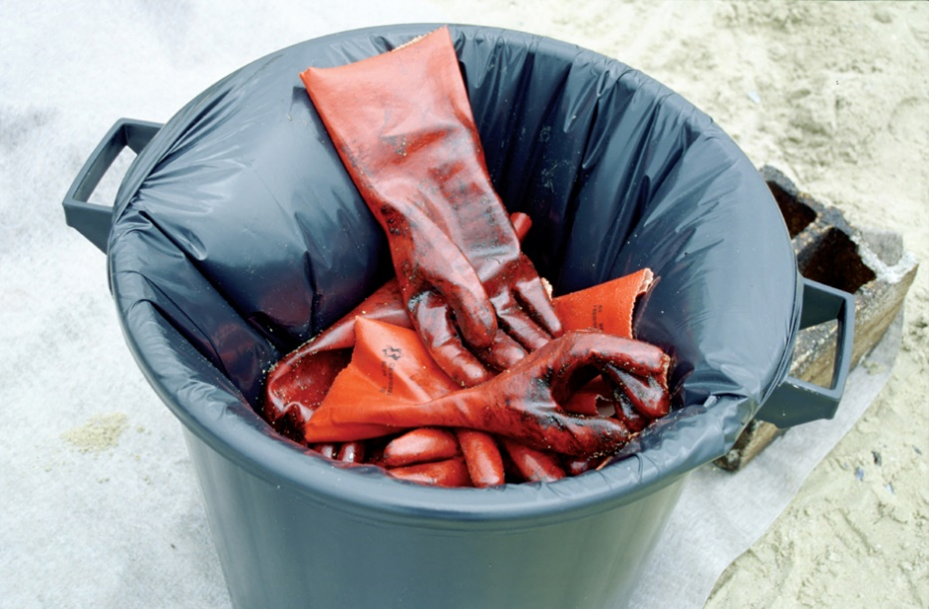
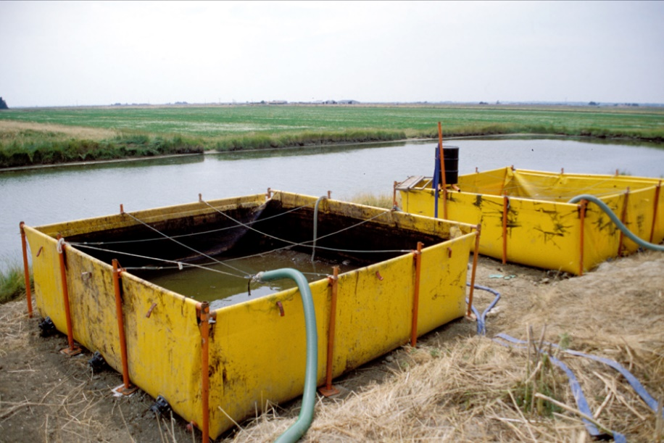
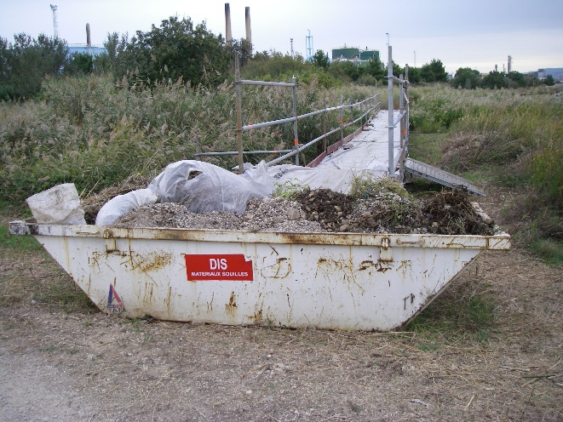
Temporary Storage − Onshore
CGPRT(W) : Ensuring Clean Seas and Coasts in Western Region ……

Slide 17
Temporary Storage − Onshore
Drums
Source: Fosse Liquitrol
CGPRT(W) : Ensuring Clean Seas and Coasts in Western Region ……

Slide 18
Temporary Storage − Onshore
Earthen pit
Source: CEDRE
CGPRT(W) : Ensuring Clean Seas and Coasts in Western Region ……

Slide 19
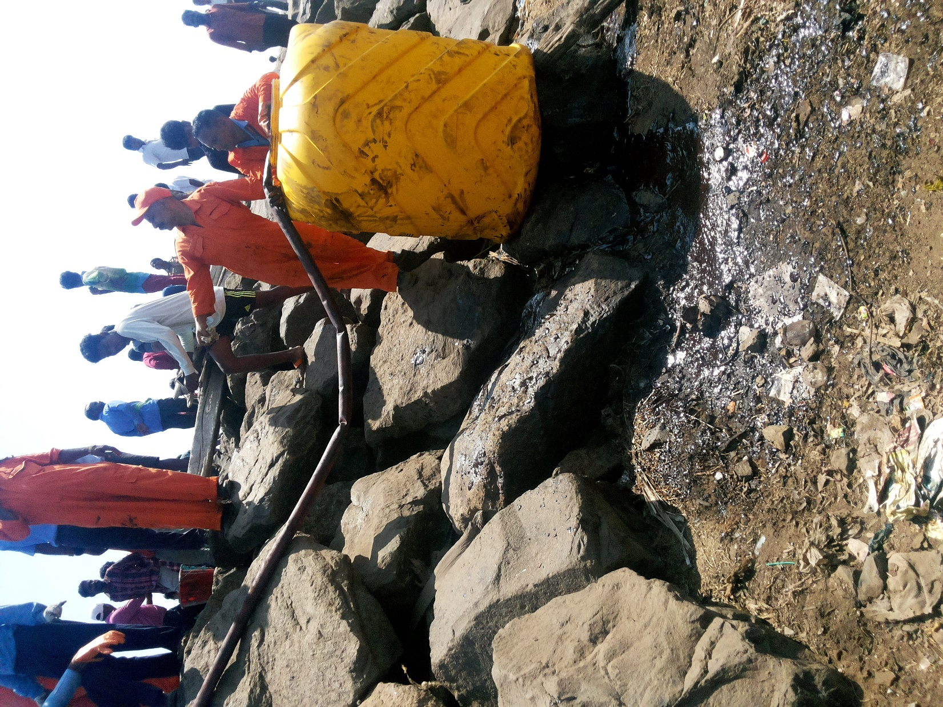
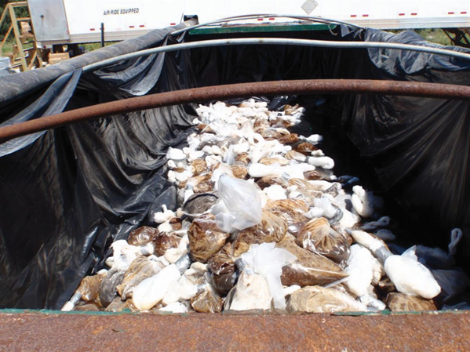
Temporary Storage - Onshore
Source:OSRL
CGPRT(W) : Ensuring Clean Seas and Coasts in Western Region ……

Slide 20
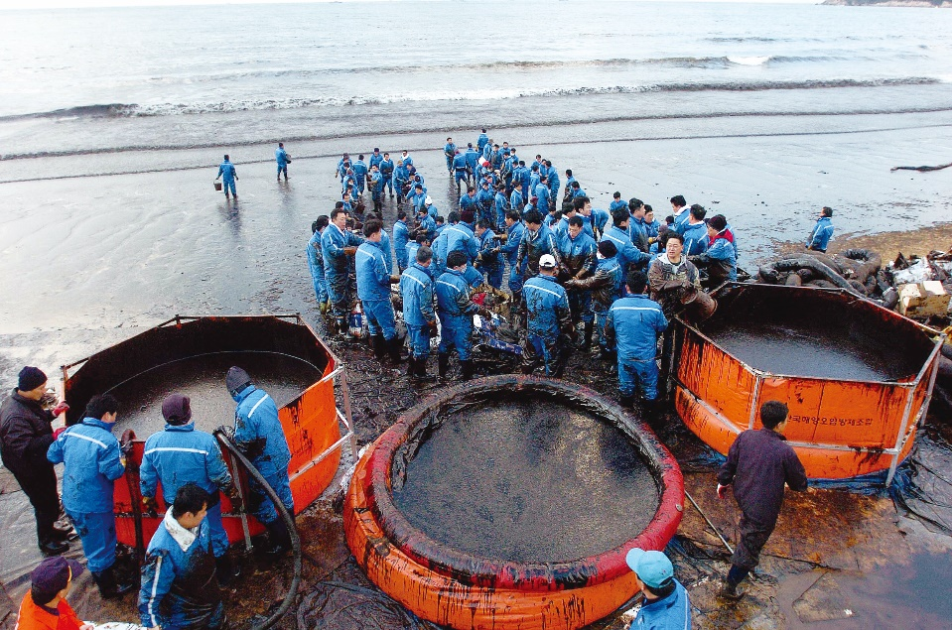
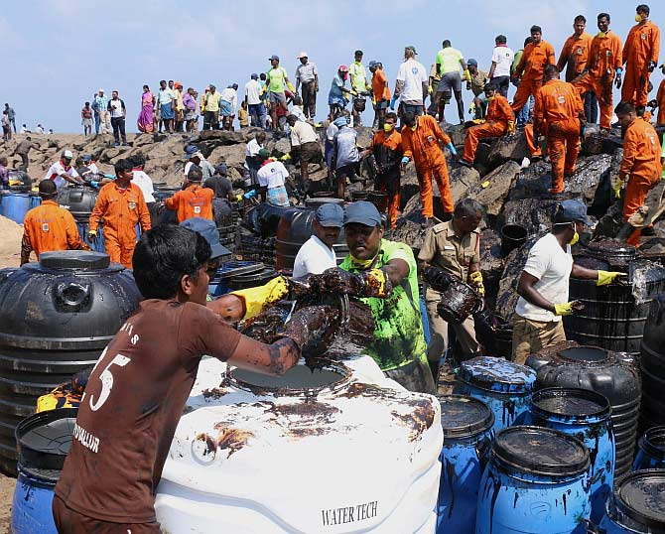
Temporary Storage − Onshore
Portable tank
Source: Korea Coast Guard
CGPRT(W) : Ensuring Clean Seas and Coasts in Western Region ……

Slide 21
Temporary Storage − Onshore
A temporary storage site is:
an emergency platform, just by the working site, for immediate deposit of the waste;
a breaking-bulk between mechanical equipment circulating on beach and those adapted to road;
a key location for sorting, labelling and quantifying the wastes collected;
a pre-treatment area for some waste to reduce volume.
CGPRT(W) : Ensuring Clean Seas and Coasts in Western Region ……

Slide 22
Temporary Storage − Onshore
Use barriers to prevent secondary contamination such as tarps/berms.
Ensure all temporary storage units are above the high water/tide mark and are not on fragile vegetation such as dune grasses.
If open containers are used they should have covers to exclude precipitation.
In accordance with local regulations.
CGPRT(W) : Ensuring Clean Seas and Coasts in Western Region ……

Slide 23
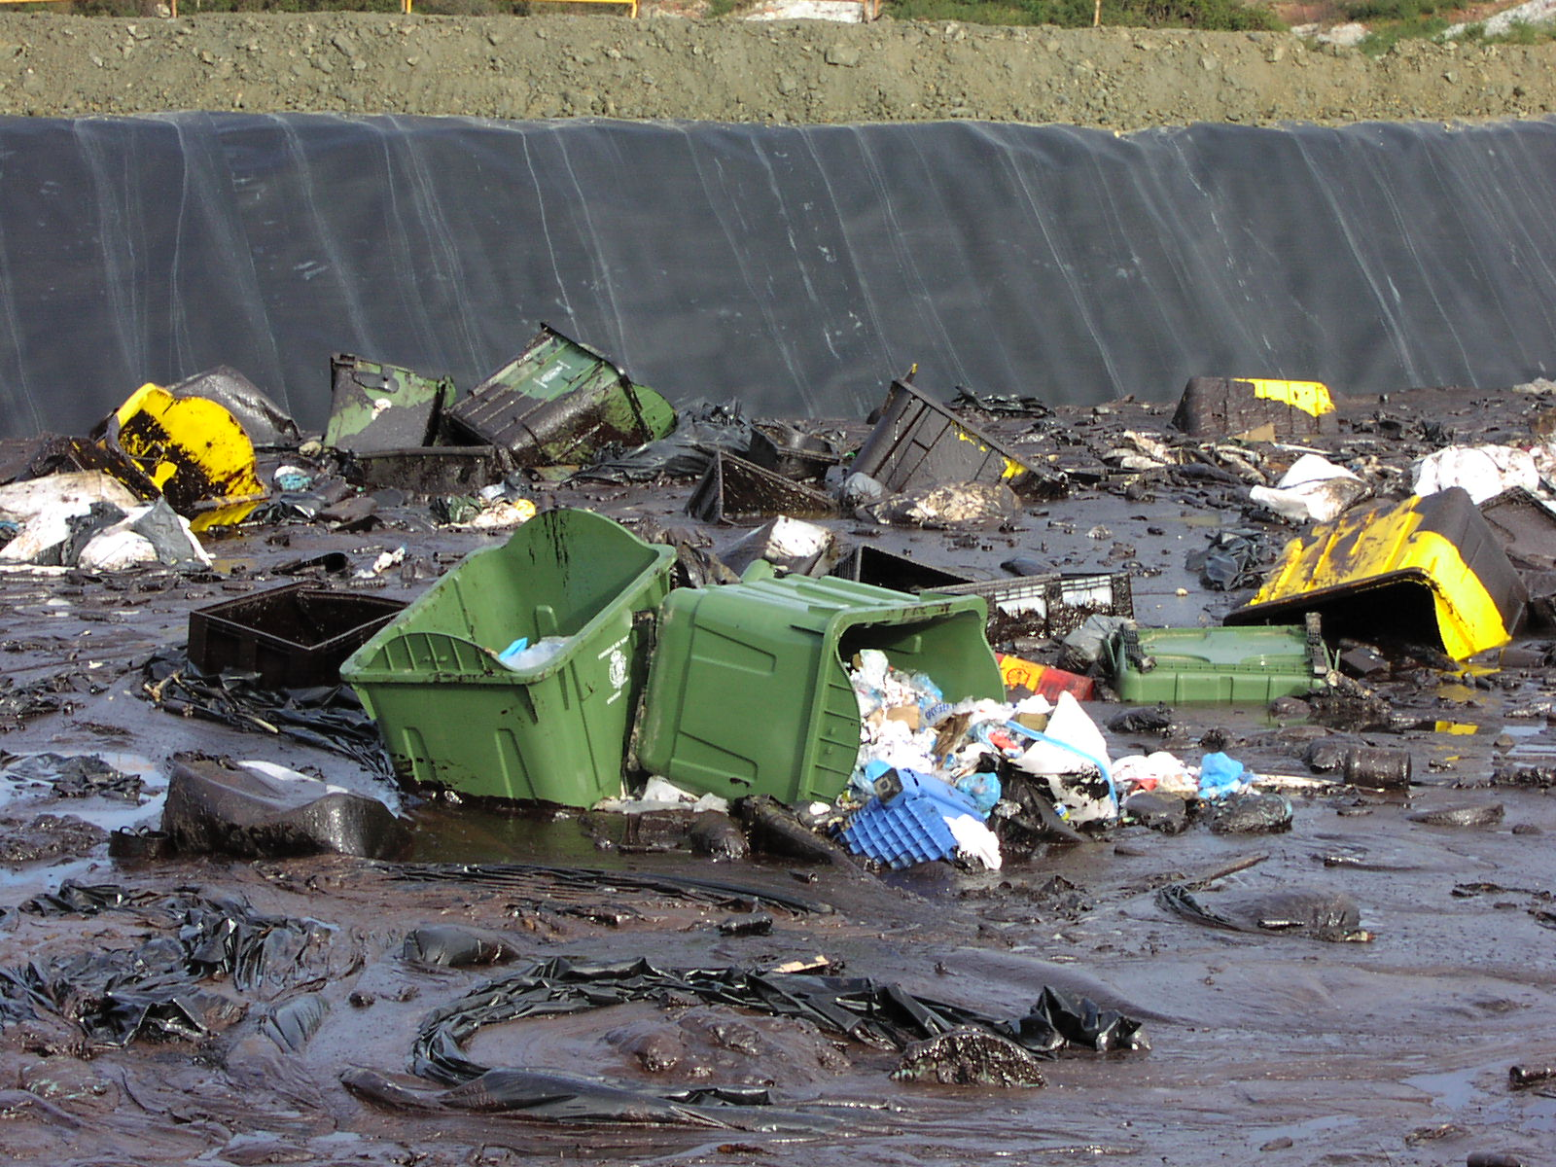
Waste Must be Separated!
By waste type
Oil
Solids (debris)
Oil content
Facilitate storage, transport and final disposal
Source: ITOPF
CGPRT(W) : Ensuring Clean Seas and Coasts in Western Region ……

Slide 24
Transportation
Minimize waste before transportation
Minimize “double handling”
Prevent oiling of new areas
(secondary contamination)
CGPRT(W) : Ensuring Clean Seas and Coasts in Western Region ……

Slide 25
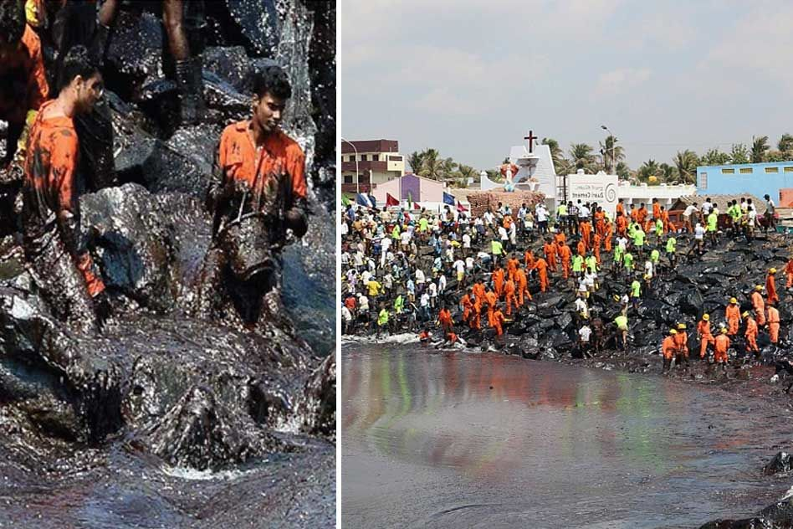
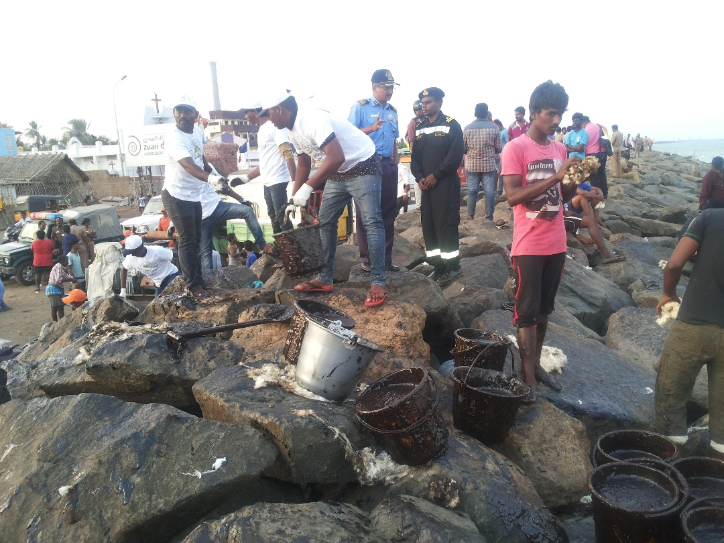
Waste Management − Logistics
CGPRT(W) : Ensuring Clean Seas and Coasts in Western Region ……

Slide 26
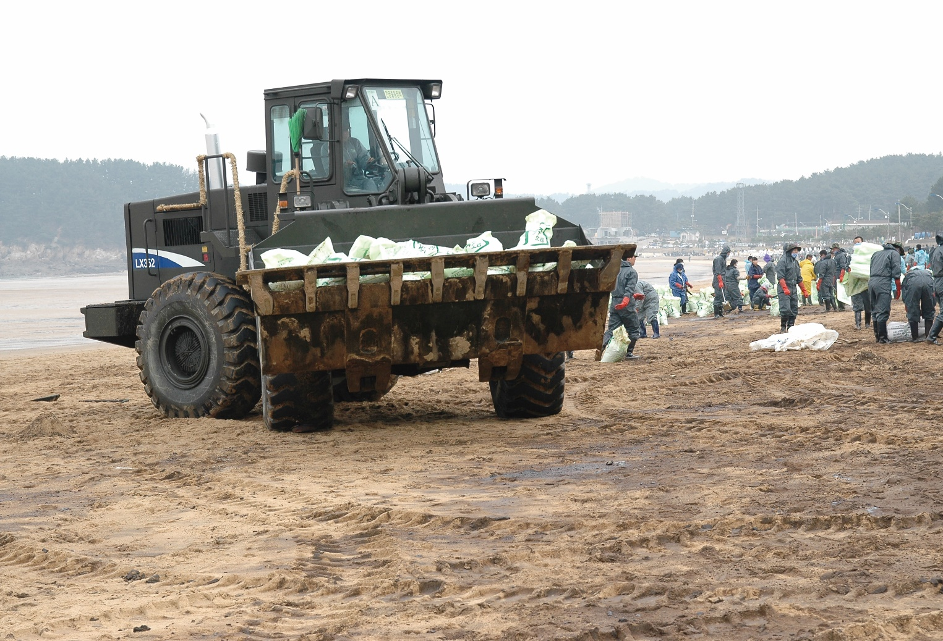
Transportation
Source: Korea Coast Guard
CGPRT(W) : Ensuring Clean Seas and Coasts in Western Region ……

Slide 27
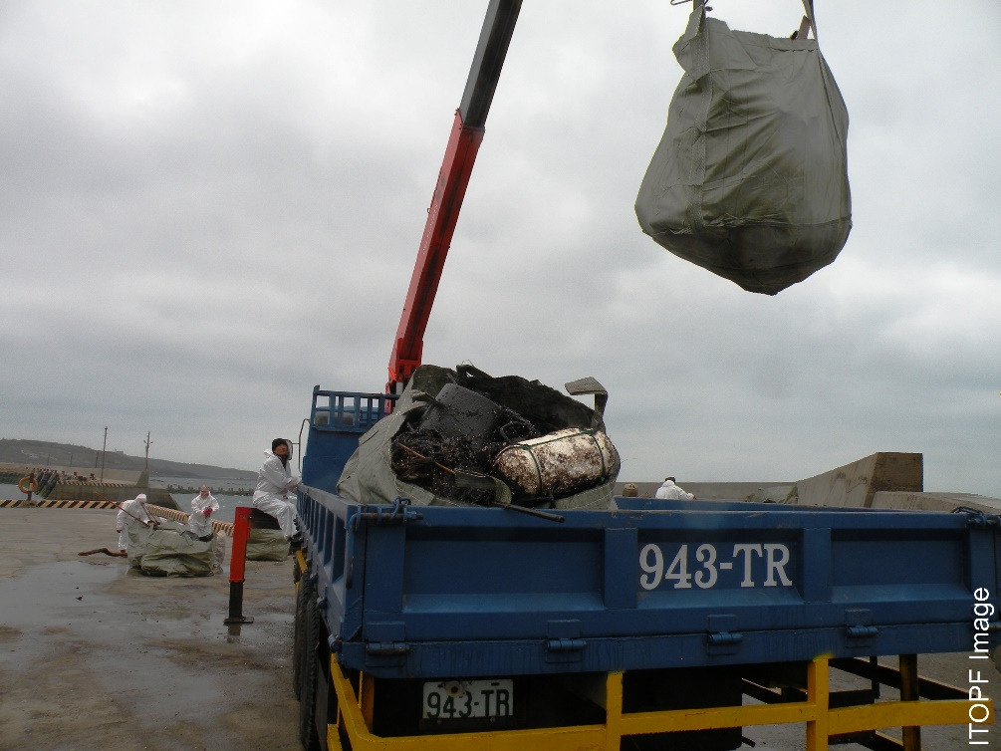
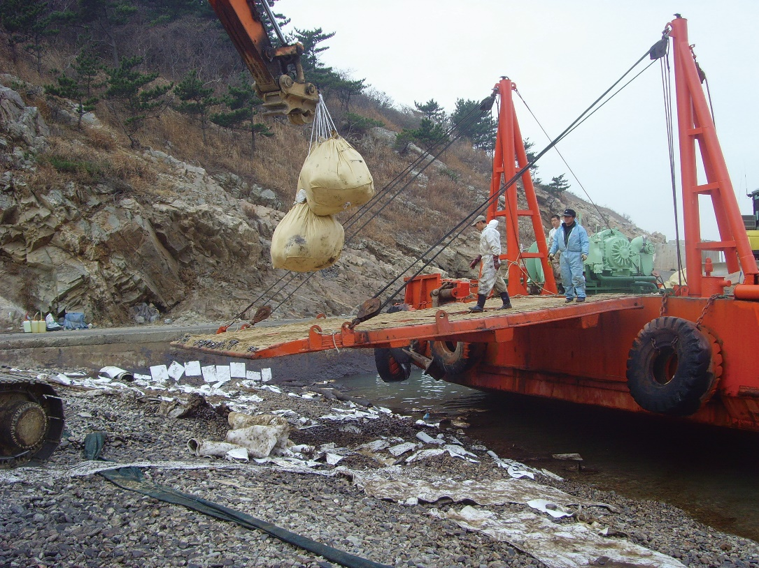
Transportation
Source: ITOPF
Source: Korea Coast Guard
CGPRT(W) : Ensuring Clean Seas and Coasts in Western Region ……

Slide 28
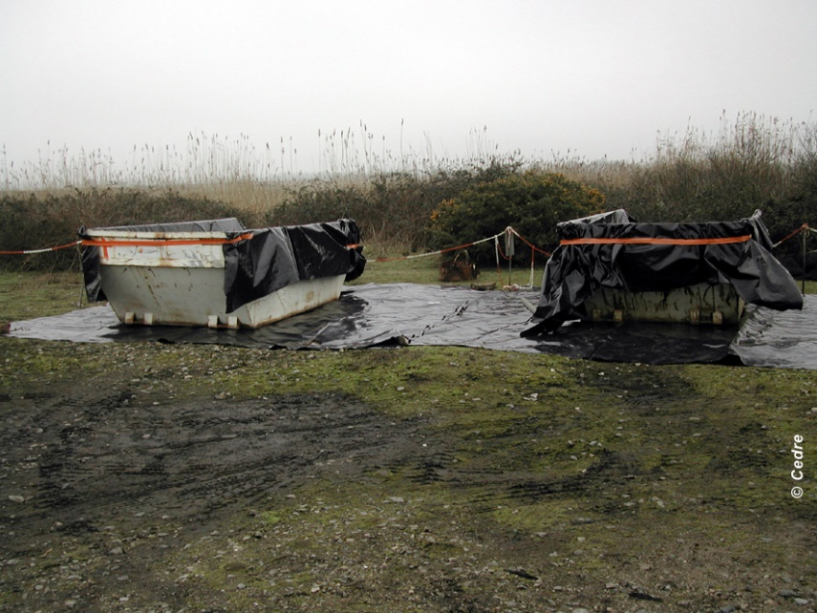
Think About Transfers!
Collect oil into containers that can store and be used for transport.
Source: CEDRE
CGPRT(W) : Ensuring Clean Seas and Coasts in Western Region ……

Slide 29
Conclusion
Waste management can affect response effectiveness.
Minimize – Segregate.
Prevent secondary contamination.
Think about the waste stream
Storage
Transfer
Transport.
CGPRT(W) : Ensuring Clean Seas and Coasts in Western Region ……

Slide 30
Any questions?
CGPRT(W) : Ensuring Clean Seas and Coasts in Western Region ……

